Slide 1
AGE DATA SET ANALYSIS
Presented by Group 3
Aditi Bharat Shinde
Meghana Jakka
Sandra Thomas
Snehal Thakur
Vidhathri MN

Slide 2
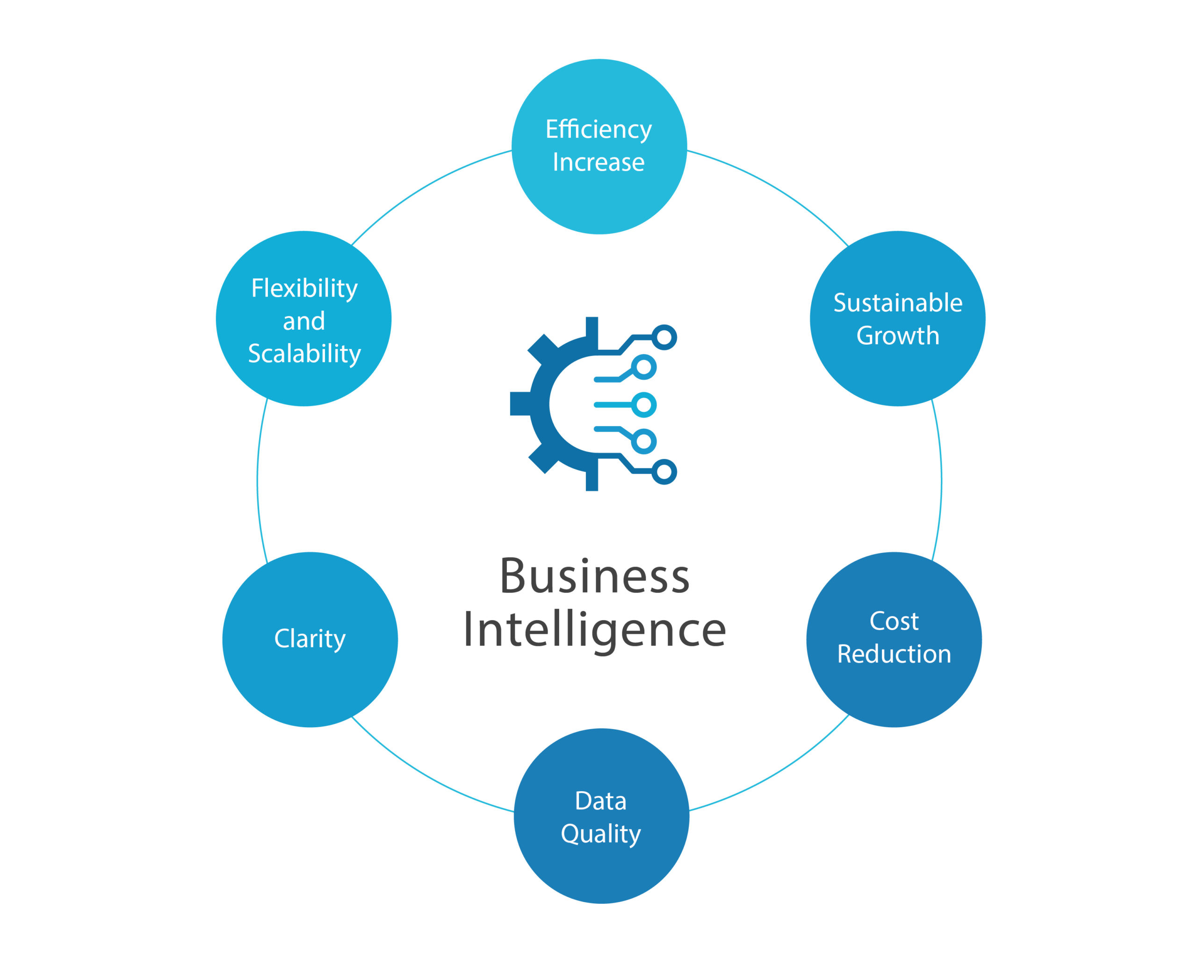
CONTENTS
Introduction
Dataset
External stage
Load the data
Creation of Task
Auto-Ingestion
SCD Implementation
Row and Column level security

Slide 3
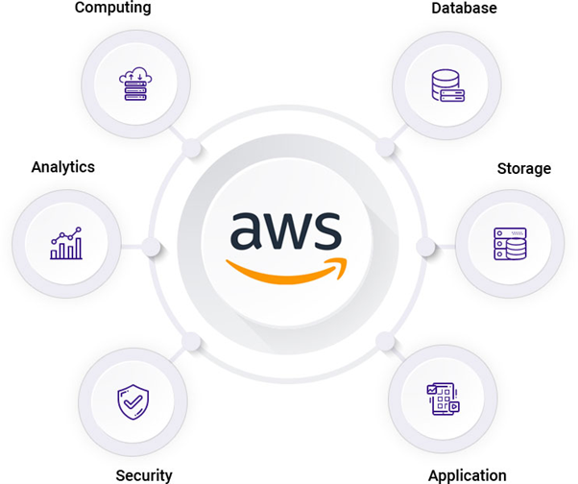
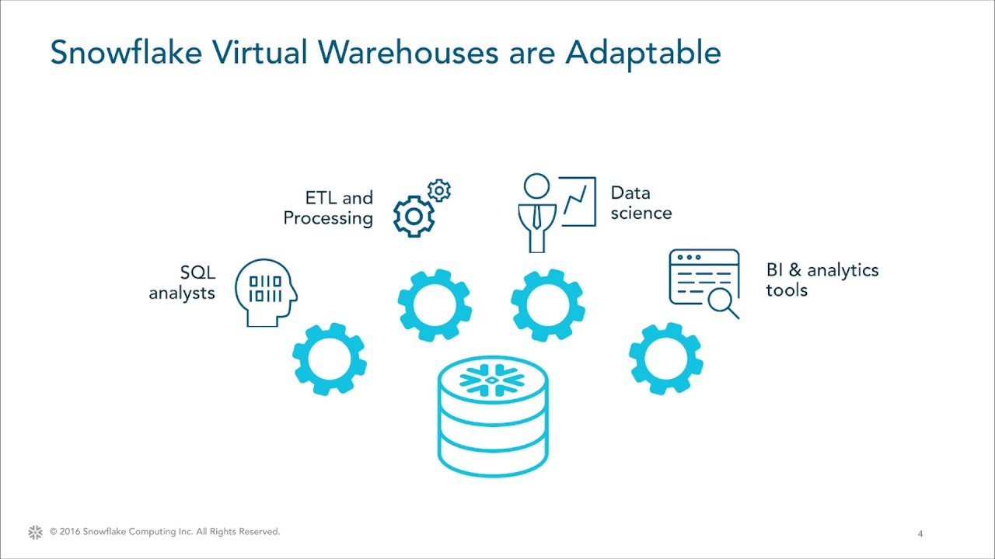
INTRODUCTION
Amazon Web Services provides a highly reliable, scalable, low-cost infrastructure platform in the cloud.
Snowflake is a SaaS (Software as a service) based data warehouse platform that is built on the top of AWS.
Notes:
Snowflake is an AWS Partner offering software solutions and has achieved Data Analytics, Machine Learning, and Retail Competencies.

Slide 4
DATASET
Age dataset
The dataset contains structured information on the life, work, and death of more than 1 million deceased famous people.
Steps for splitting up of dataset:
Age dataset01
Age dataset02
Using python
Age dataset
|
|
|
Age dataset15
Notes:
It is the largest on notable deceased people and includes individuals from a variety of social groups, including but not limited to 107k females, 124 non-binary people, and 90k researchers, who are spread across more than 300 contemporary or historical regions. The final product provides new insights into the demographics of mortality in relation to gender and profession in history. As the dataset contains around 12 lakh records, our group decided to split up dataset into 15 files and each file respectively contains 80000 records.

Slide 5
EXTERNAL STAGE
Step 1 - Create a S3 bucket in AWS
Step 2 - Upload the objects i.e. dataset files
Step 3 - Creating role and policy for the s3 bucket
Step 4 - Create the storage integration
Step 5 – Update trust relationship policies
Step 6 – Create file format
Step 7 - Create external stage
Step 8 – Loading data from
Notes:
Syntax and which steps added, why added this code
A storage integration is a Snowflake object that stores a generated identity and access management (IAM) entity for your external cloud storage, along with an optional set of allowed or blocked storage locations (Amazon S3) A single storage integration can support multiple external stages.

Slide 6
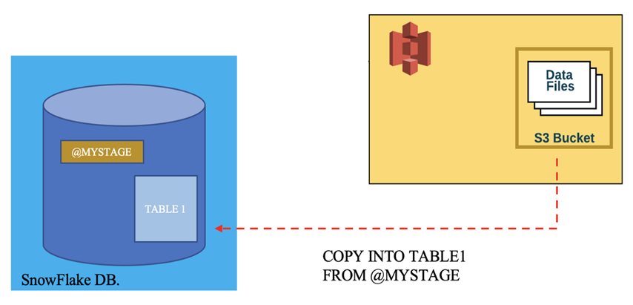
LOAD THE DATA
Step 1- Creating a table
Step 2- Loading data to table from external stage
Notes:
Syntax and which steps added, why added this code

Slide 7
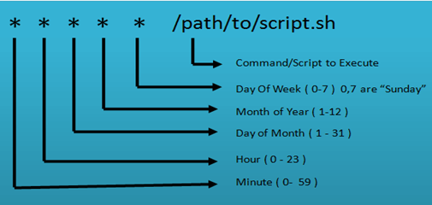
CREATION OF TASK
A task generally runs on a schedule and can define the schedule when creating a task (using CREATE TASK)
Setting up a task using crontab according to our schedule
Check for the scheduled task
Put task in the schedule
Notes:
Syntax and which steps added, why added this code

Slide 8
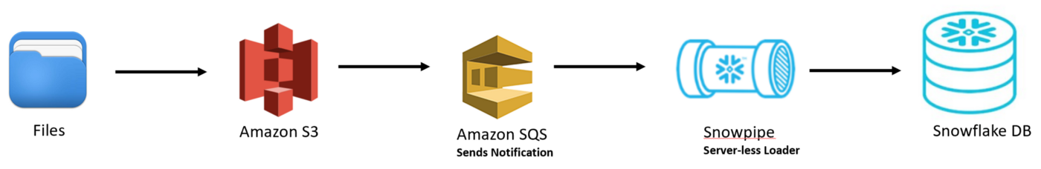
AUTO-INGESTION
Auto-ingest feature relies on SQS queues to deliver event notifications from S3 to Snowpipe.
Steps:
Step 1- Create the Snowpipe
Step 2- Create a event notification in S3 bucket
Step 3- Check the status of Snowpipe
Step 4- Upload the file in S3 bucket
Step 5- Refresh the Snowpipe
Notes:
Each record contains the effective time and expiration time to identify the time period between which the record was active.

Slide 9
SCD IMPLEMENTATION
Steps:
Create a stream
Creating a target table
Make changes in the table
Create or resume the task
Merge stream and target table
Check for the changes in the table
Notes:
Syntax and which steps added, why added this code A task is a new Snowflake object type that defines a recurring schedule for executing SQL statements, including statements that call stored procedures. A table stream allows you to query a table and consume a set of changes to a table, at the row level,

Slide 10
ROW AND COLUMN LEVEL SECURITY
Row-level and Column-level access control is used to restrict access to certain types of information.
Steps to implement row-level security:
Creating roles
Creating a table for roles and aliases
Creating users
Creating view
Granting access to the users
Notes:
Syntax and which steps added, why added this code
Given the right conditions, row-based security can be an important form of data protection control.
Row-level access control should prevent any user from retrieving data from other regions while preserving the ability to query data about own region.

Slide 11
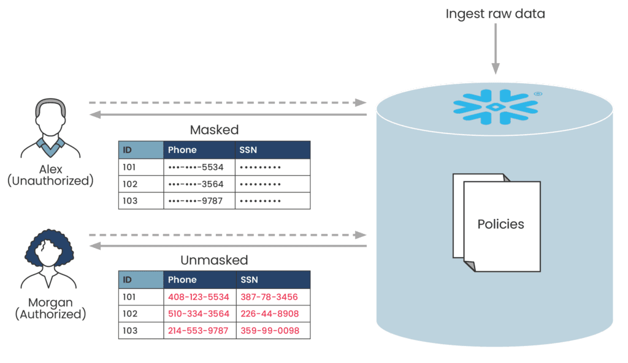
Steps to implement column-level security:
Creating a masking policy
Creating a role
Applying masking policy on table
Granting permission to role
Fetching the data
Notes:
Syntax and which steps added, why added this code

Slide 12
THANK YOU
Notes:
Syntax and which steps added, why added this code

